Slide 1
Art^2
Becky Miller, David Castro, Marie Chu, Leyth Toubassy

Slide 2
“Learn Art and Build your Community
– One pixel at a time”

Slide 3
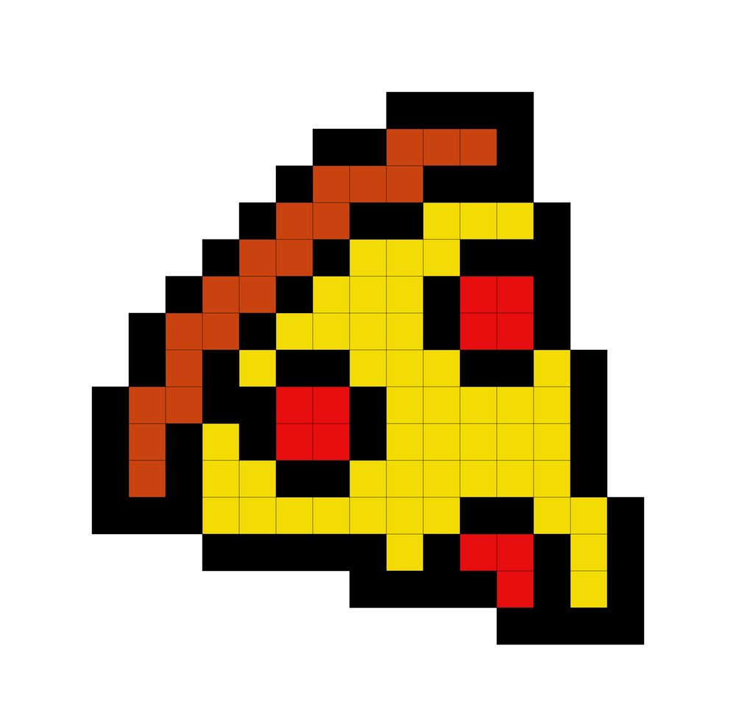
Problem
Solution
People don’t continue art after formal education because it is time consuming and they aren’t good it. This makes them hesitant to share their work with others since they’re not proud of their art.
App that allows users to learn an artistic medium with a lower barrier to entry (pixel art) and collaborate with others to build a community.

Slide 4
Values in Design
Creativity
Main feature is freestyle pixel art
Community
Share and collaborate on pixel art
Connect with friends on app
Inclusion
Optional lessons for all levels of artists
Simplicity
Simple app design and grayscale colors to make user’s art pop
Inclusion of only the necessary tools on each page
Notes:
Tension: making it fun and interactive promotes longer screentime which could lead to health issues such as eye strain, sedentary lifestyles, etc.

Slide 5
Tensions
Health
Promotes screen time
Eye strain
Sedentary lifestyle
Accessibility
More difficult for those with lack of motor control
Inclusion
Not accessible for those without access to mobile devices
Notes:
Tension: making it fun and interactive promotes longer screentime which could lead to health issues such as eye strain, sedentary lifestyles, etc.

Slide 6



Tasks
1. Create a pixel art piece
(simple)
2. Share a pixel artwork (moderate)
3. Collaborate on a pixel artwork (complex)
*No changes were made to the tasks
Notes:
No changes were made to the tasks

Slide 7
Usability Goals & Key Measurements
Fun
Measured with 5 point Likert scale
Robust
Number of misclicks/errors user makes when performing task
How fast they can recover from failure
Progress?: On track to hitting these goals

Slide 8
Interface Revisions

Slide 9
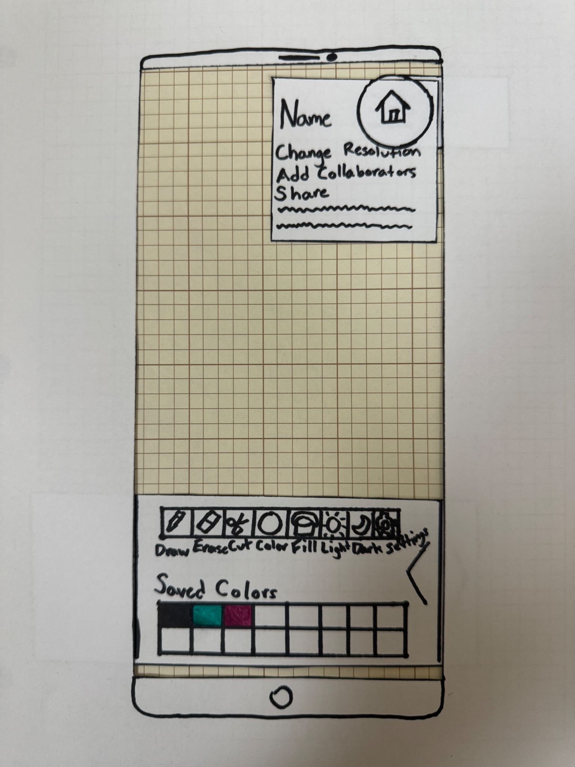
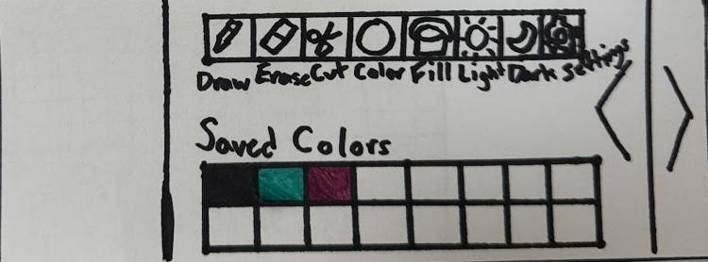
Design change #1 - Before
How can we make drawing pixel art more simple? How can we reduce our toolbar to be more intuitive to reduce errors?
Low-fi drawing page
Low-fi Toolbar

Slide 10
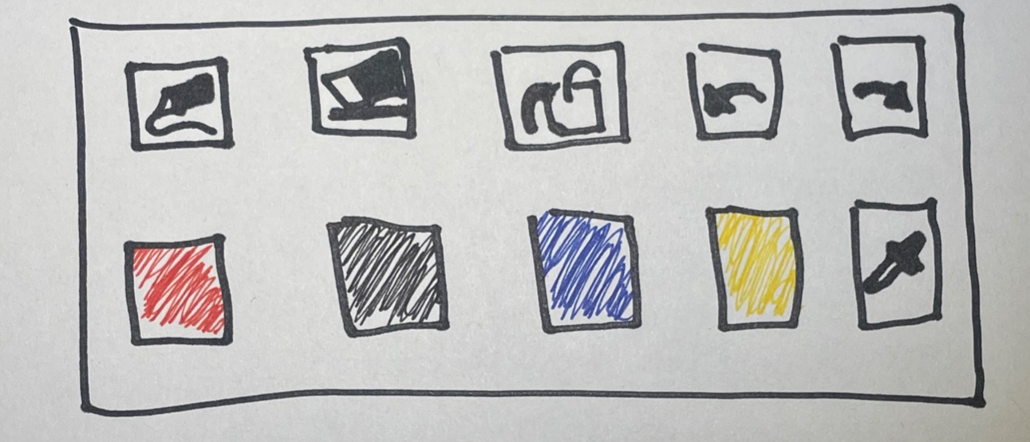
Design Change #1 - After
Feedback: “Maybe you could make drawing a pixel simpler there was a lot going on with the toolbar.”
Change:
Reduced toolbar to having just 6 functions w/ 4 colors.
Rationale:
We wanted the most important features present.
Our design is simple so for consistency we wanted to make the toolbar simpler and more intuitive.
We noticed that there was a lot clutter in our toolbar.

Slide 11
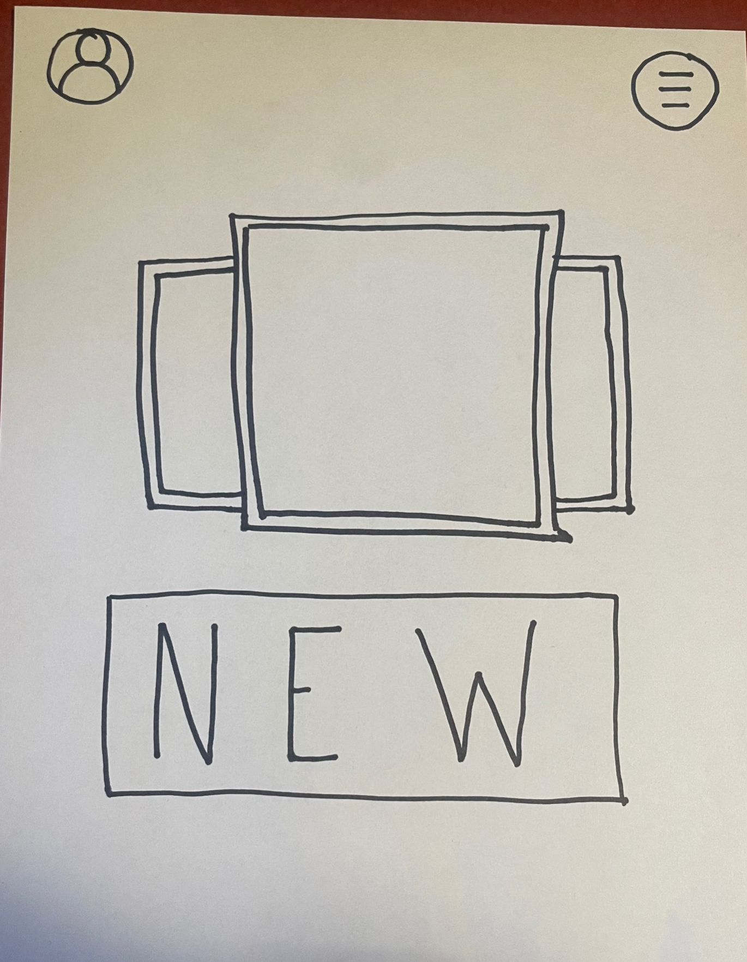
Design Change #2 - Before
How can we make our core value of collaboration more visible? How can we emphasize building community to create a fun experience?
Low-fi Home page

Slide 12
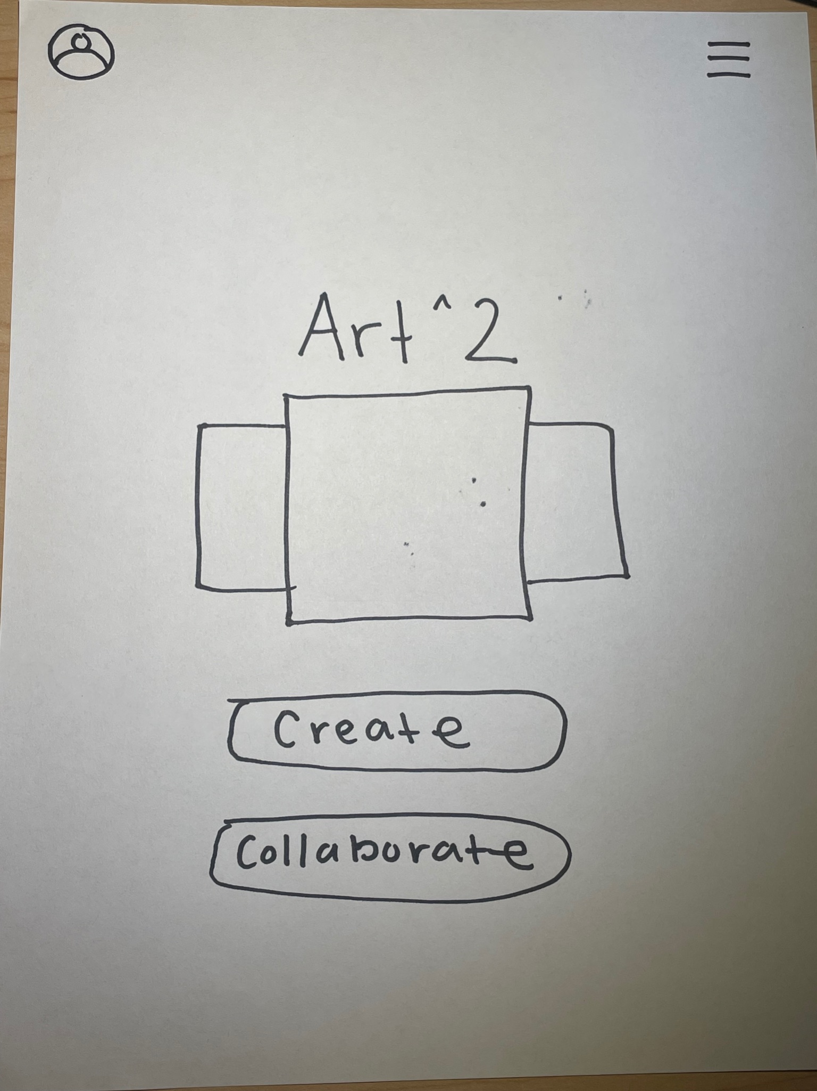
Design Change #2 - After
Feedback: “Make collaboration more apparent because it’s one your goals.”
Change:
We added a collaboration button on the home page to emphasize community
Rationale:
Feedback we heard was that a key part of our goal was hidden behind the hamburger menu
We wanted easier access for the user to build a fun community
To be consistent with our values we decided to move collaboration to home page.

Slide 13
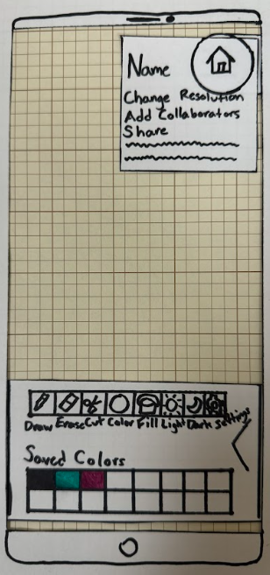
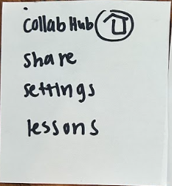
Design Change #3 - Before
How can we make navigating the app through navigation menus more clear and intuitive and lead to a more robust application?

Slide 14
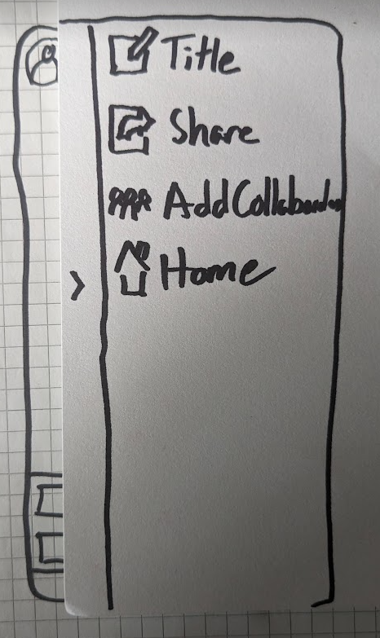


Design Change #3 - After
Feedback: reading through the navigation menus is slow
Change:
Make navigation menus larger
Add icons to navigation options
Have different icons, vs , for homepage and canvas navigation respectively
Rationale:
Larger menus allow for larger text and fewer distractions while menu is open
Icons are a quicker visual cue than text
The same icon in two different places leading to different things could be confusing

Slide 15
Medium-fi task flows

Slide 16
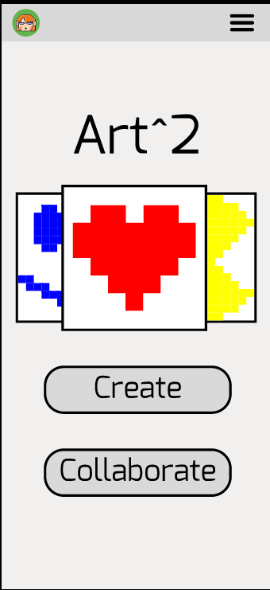
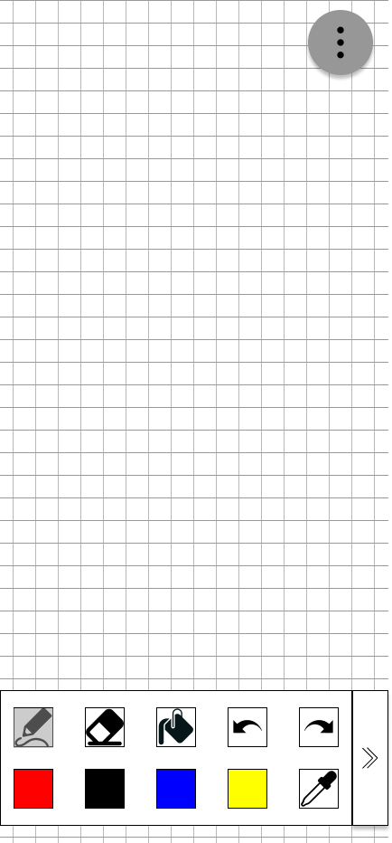
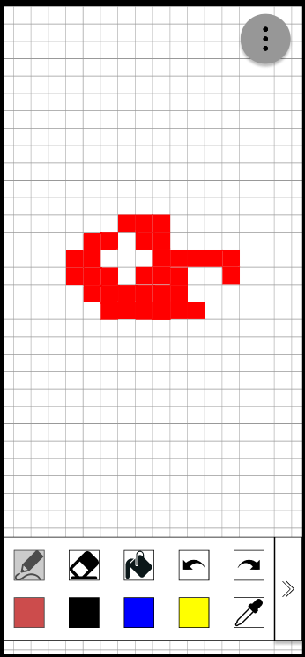
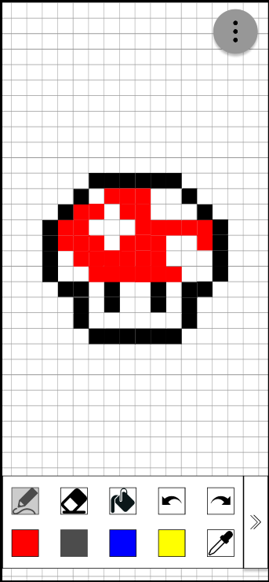
Task #1: Create

Slide 17
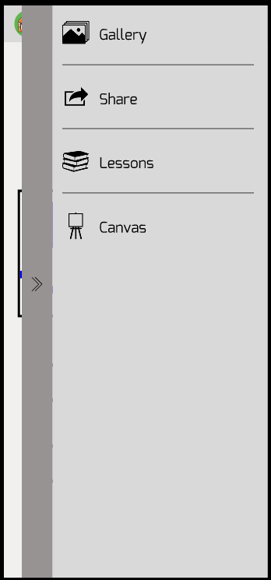
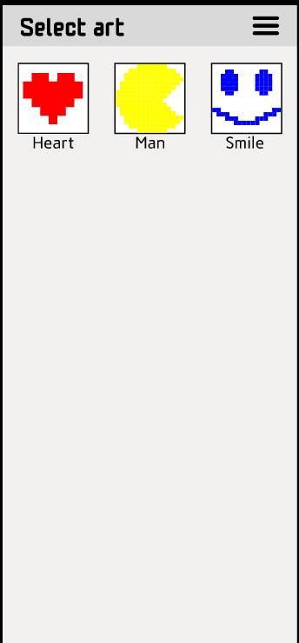
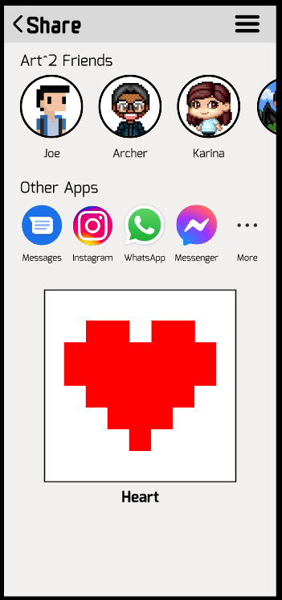
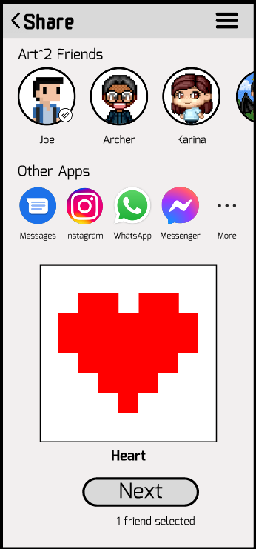
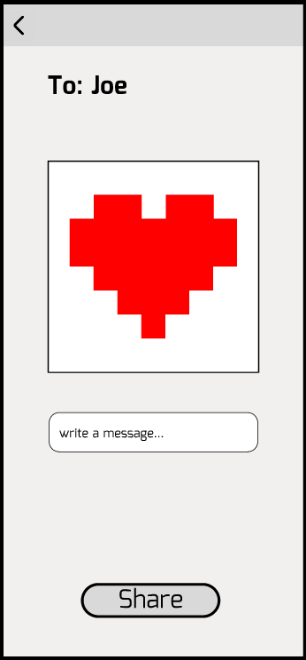
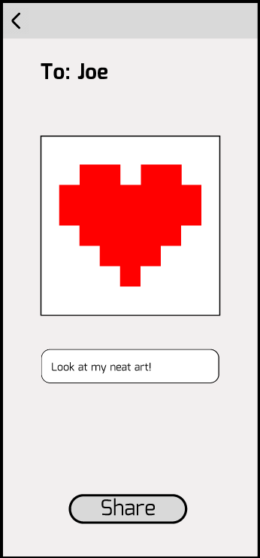
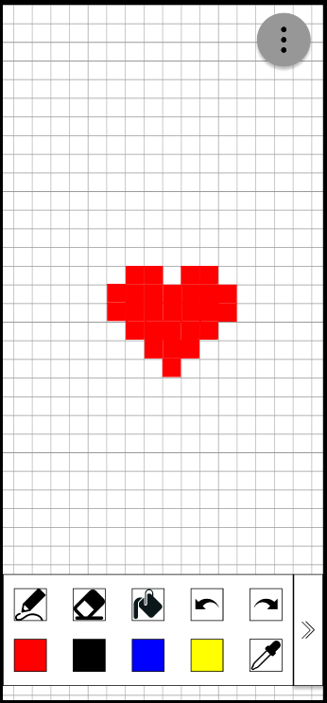
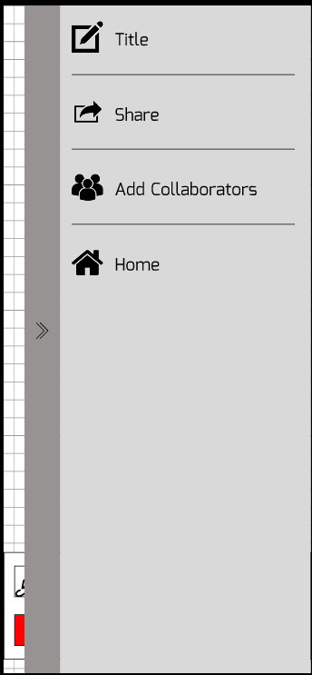
Task #2: Share

Slide 18
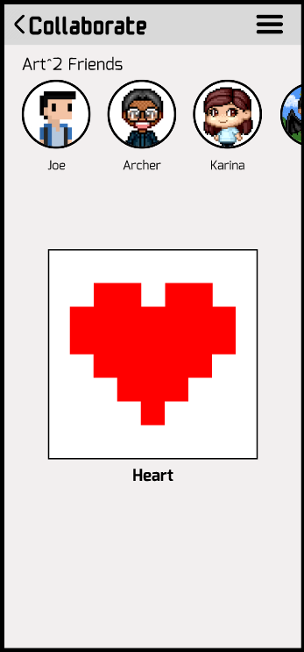
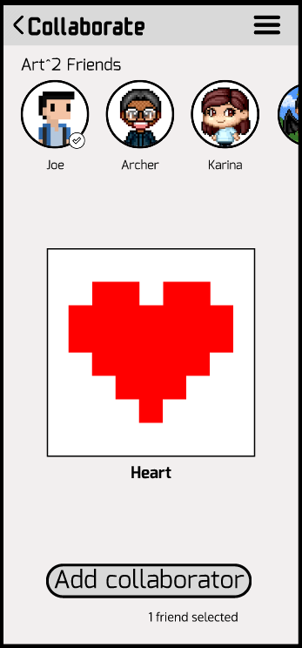
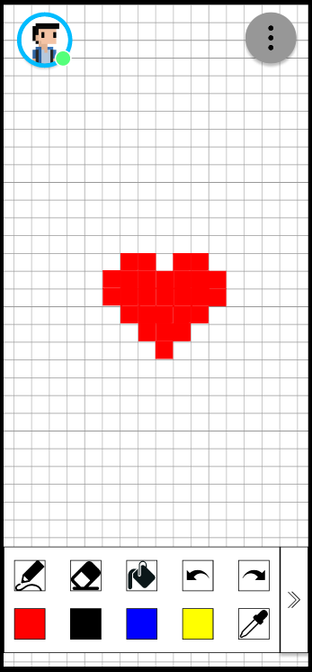
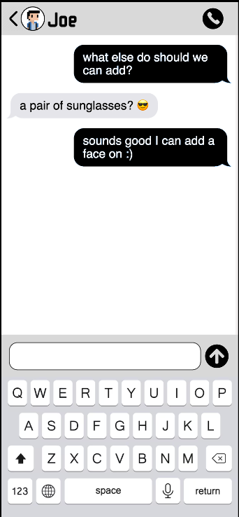
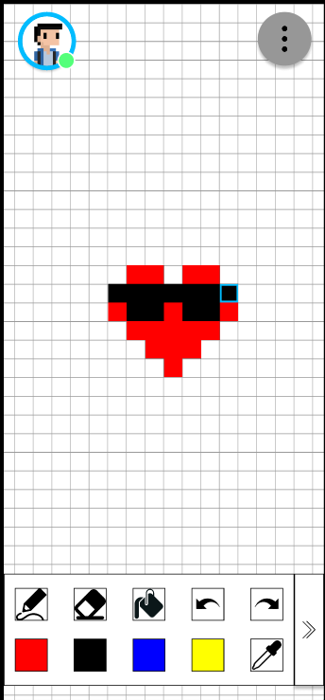
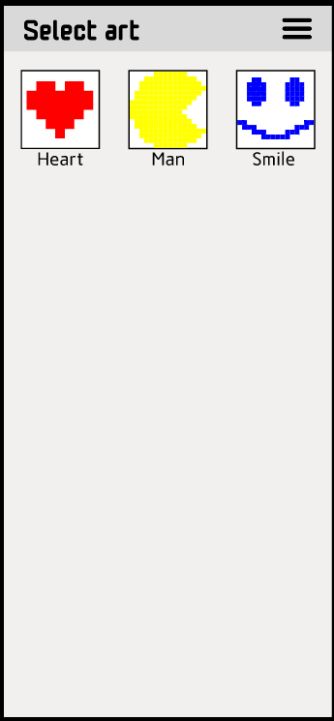
Task #3: Collaborate

Slide 19
Prototype Implementation
This medium-fi prototype was created using Figma. The prototype is designed to mimic screens and interactions on our mobile application.
Pros:
Real time collaboration
Can prototype design and interactions
Componentize
Auto layouts
Cons:
High learning curve
Too much functionality
Slow to open
Unable to accurately mimic user’s experience without state

Slide 20
Limitations
Correct tooling behavior in the canvas page
Zooming into and moving around the canvas
→ Impractical to create multiple screens for all permutations
Flushed out lessons
→ isn’t one of the main tasks, need to curate useful content for it
Interactive chat functionality
→ cannot implement this with one user

Slide 21
Wizard of Oz - Canvas
User clicks on drawing tool and all red squares are filled in
User clicks on black color and drawing is completed
Implemented in this way as there would be too many permutations of screens to be built out if the user could selected each square they want to draw individually

Slide 22
Wizard of Oz - Collaborate
Messages with friends automatically populated after adding collaborators
Difficult to mimic interaction between two parties on Figma with one user

Slide 23
Wizard of Oz - Home/Gallery
User already has pre-populated drawings that were created
Makes the app look more appealing than blank artwork

Slide 24
Hard coded features
Created drawings
Messages
Share/Collaborate flow

Slide 25
Figma Link

Slide 26
THANKS
Please keep this slide for attribution

